Slide 1

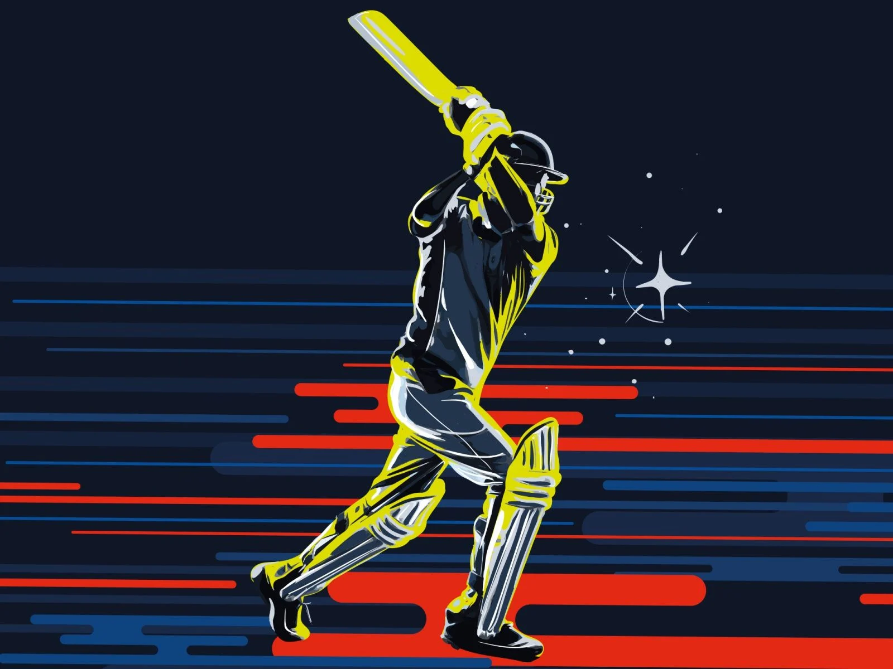


IPL ADVERTISING IMPACT ANALYSIS
BY: ANURAG MISHRA

Slide 2

ABOUT ME
I’m an aspiring data analyst focused on transforming IPL advertising data into insights that balance business value and social impact. In my latest project, I built a Power BI dashboard using SQL and Excel to highlight revenue trends, health risks, and ethical ad practices — showcasing my ability to drive both data-driven and responsible decision-making.

Slide 3
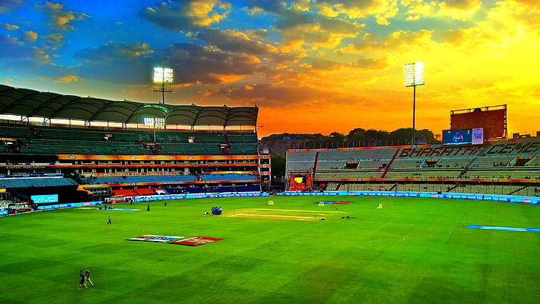
PROBLEM STATEMENT
IPL’s advertising landscape currently suffers from weak regulation, allowing harmful products like pan masala and betting apps to be promoted widely. Celebrity endorsements lack oversight, contributing to rising public health and social concerns. This project aims to highlight the risks and recommend data-driven solutions.

Slide 4
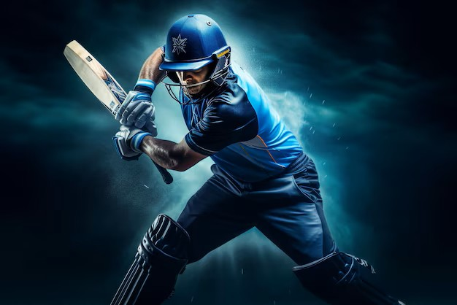
GOALS TO ACHIEVE
The goal is to analyze IPL advertising data using Power BI and SQL to uncover the impact of high-risk brands, estimate affected populations, and propose ethical policies. The project combines business intelligence with social responsibility to improve future IPL ad strategies.

Slide 5
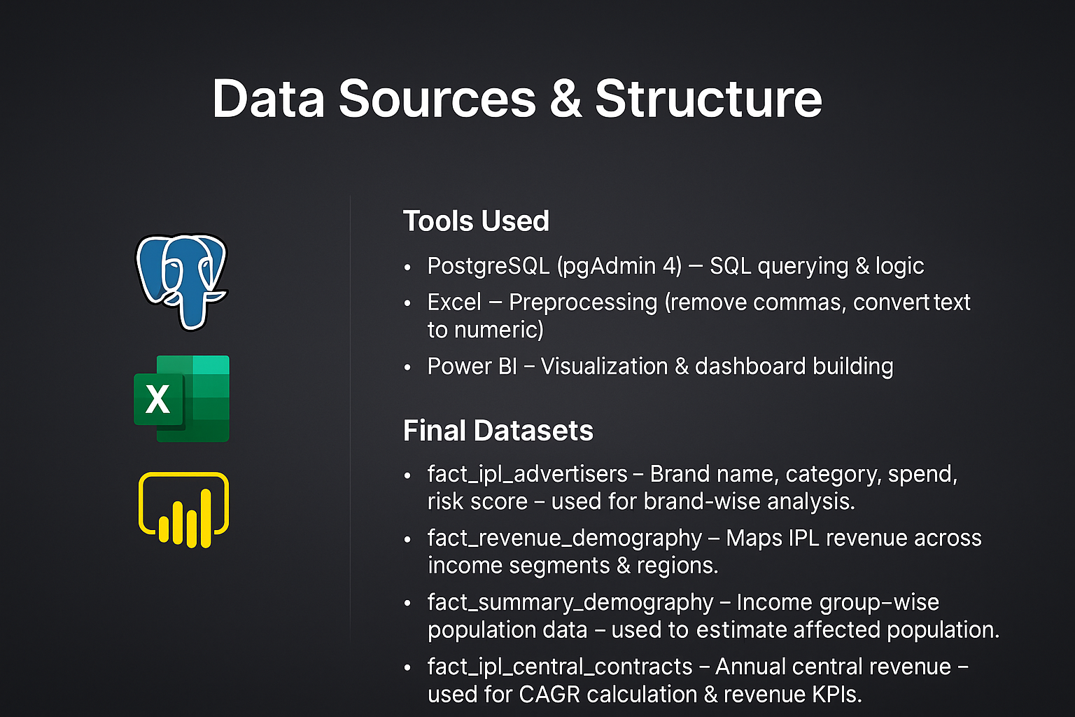

Slide 6
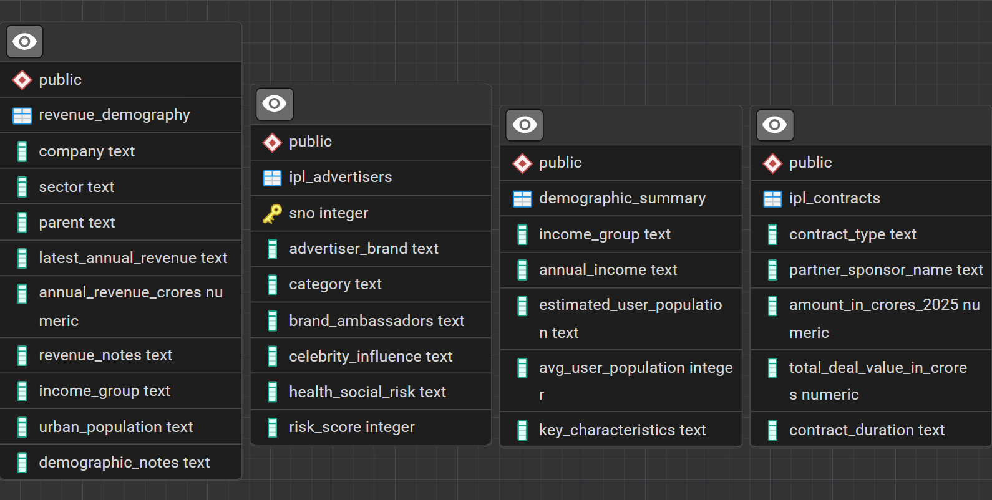

Slide 7
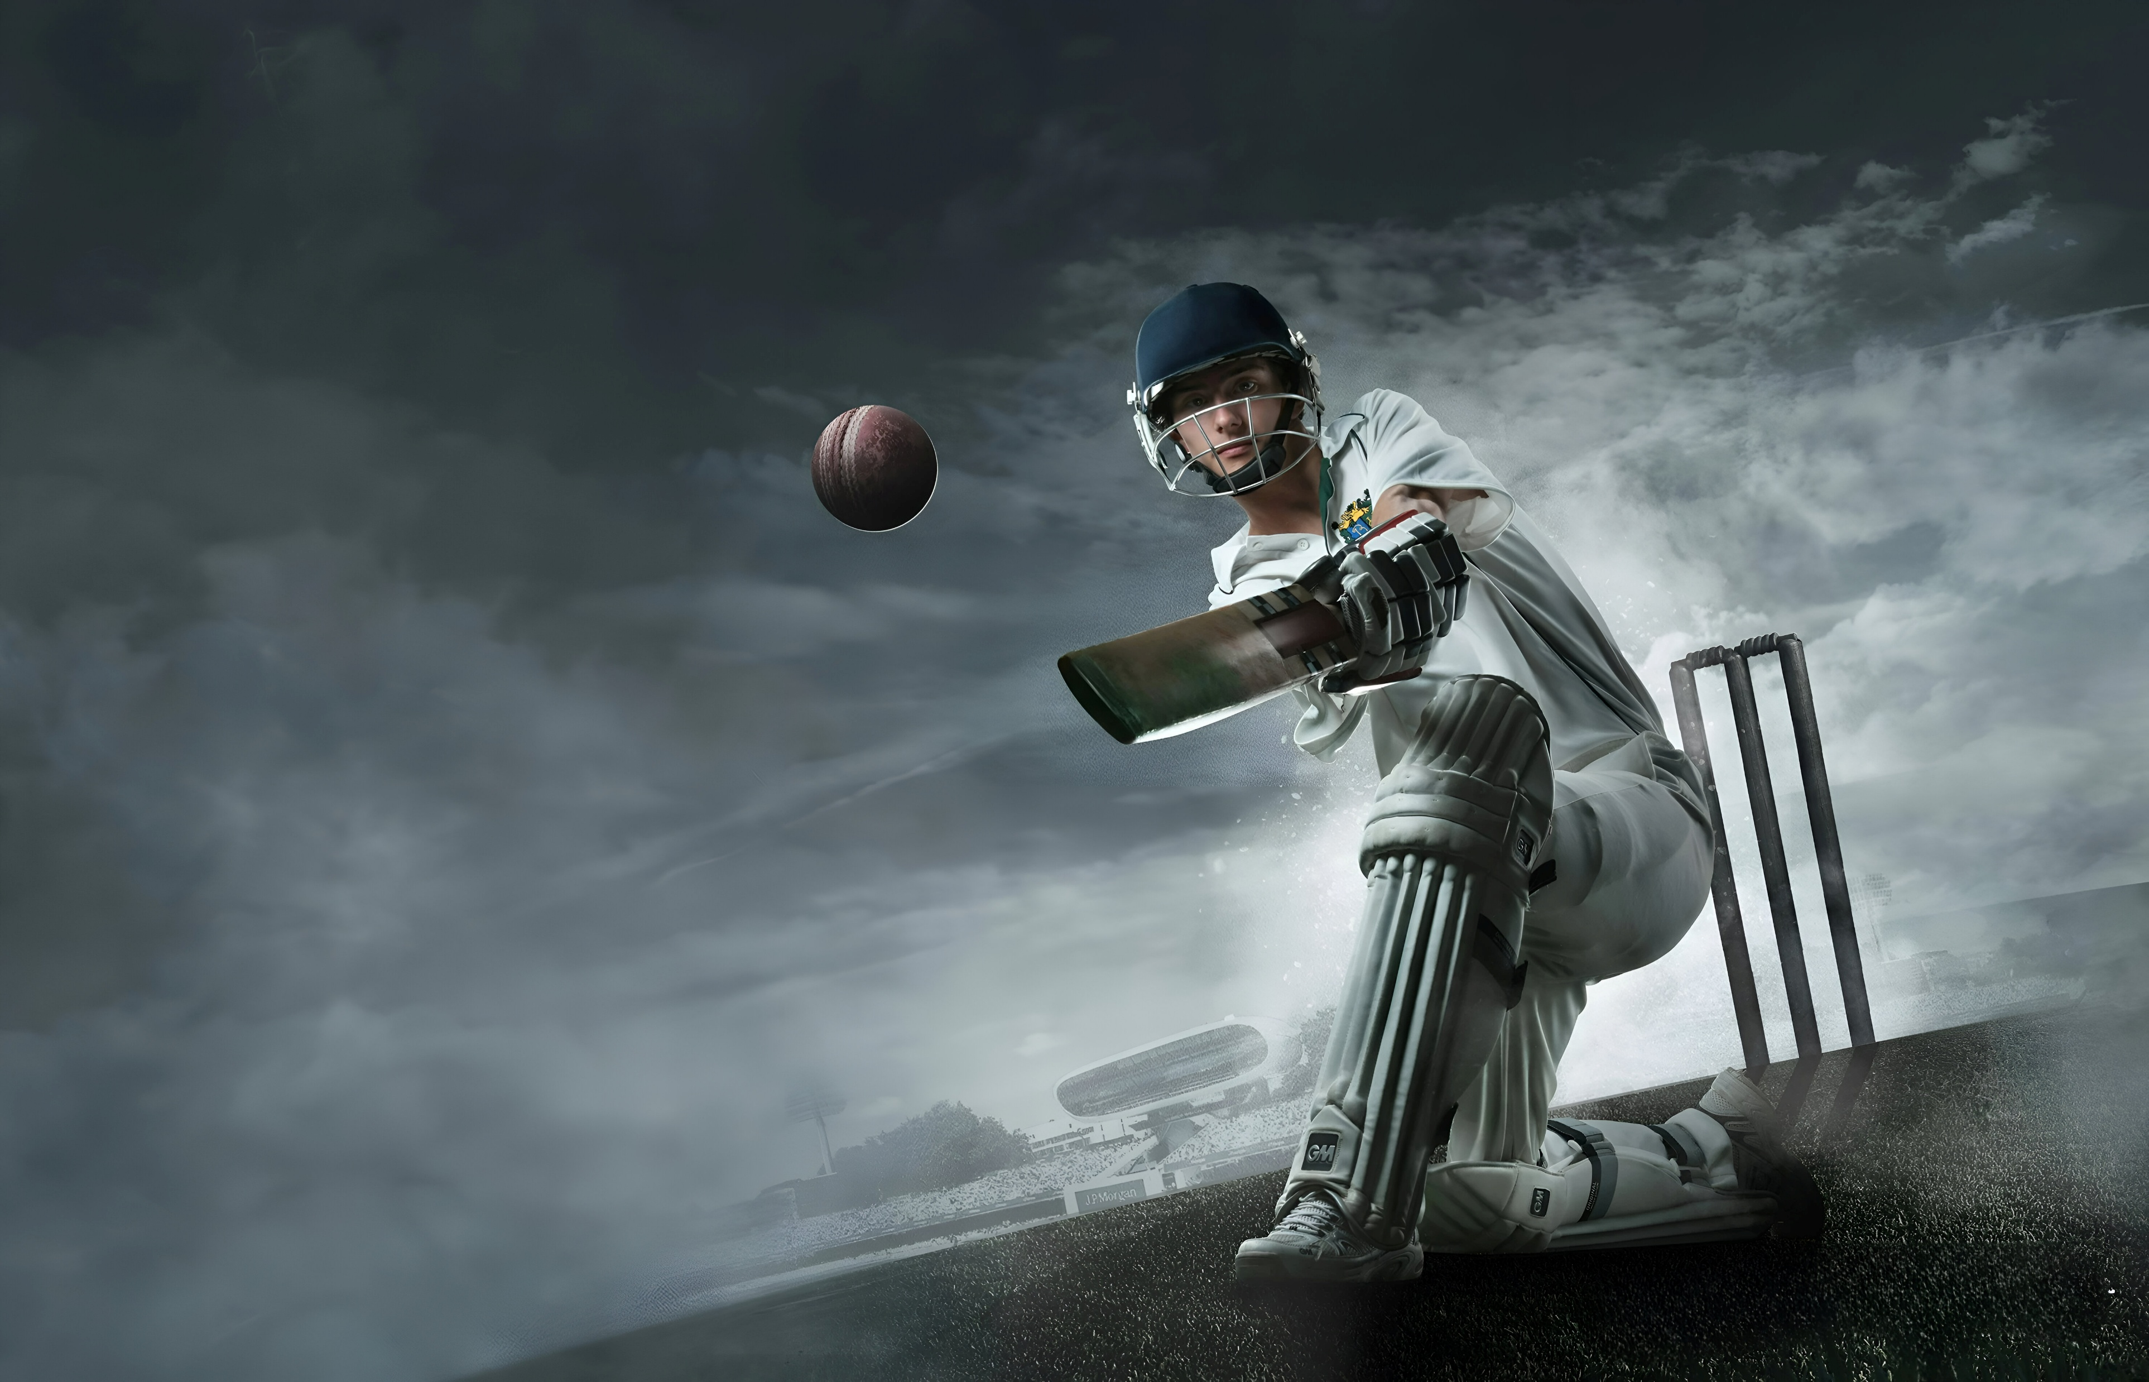
SQL LOGIC & TRANSFORMATIONS
Estimated affected population (15% of relevant segments) using income & region filters.
Identified high-risk brands (with risk_score ≥ 4) for brand ethics analysis.
Calculated total central revenue from fact_ipl_central_contracts.
Applied CAGR formula: CAGR = (Future / Present) ^ (1 / n) - 1
Estimated ₹3,333 per person health cost → Based on ₹1.5L Cr impact over 45 million people.

Slide 8
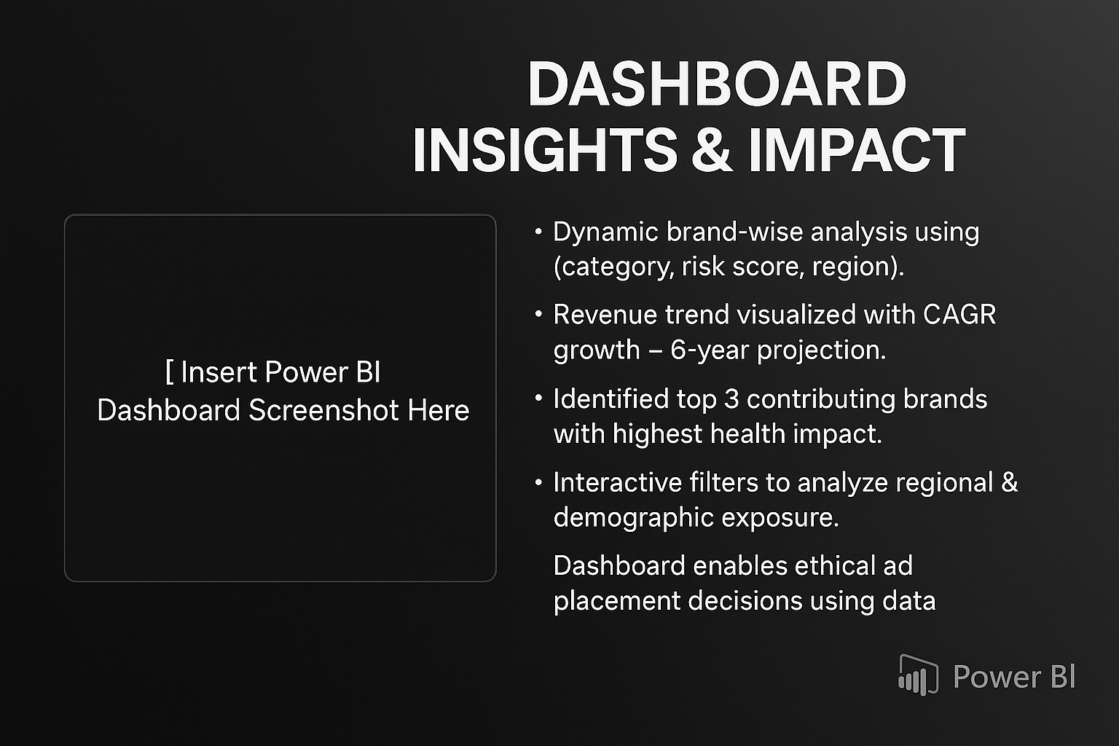
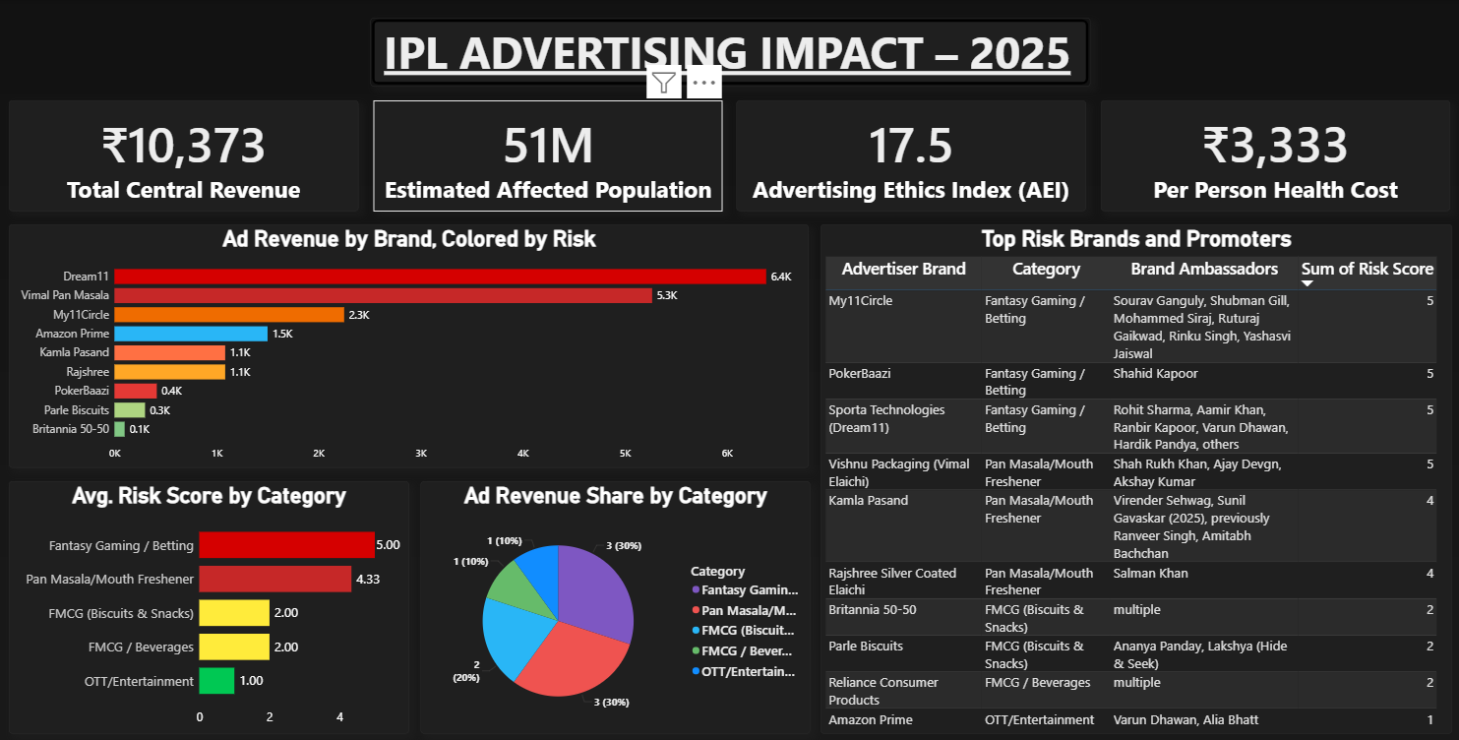

Slide 9
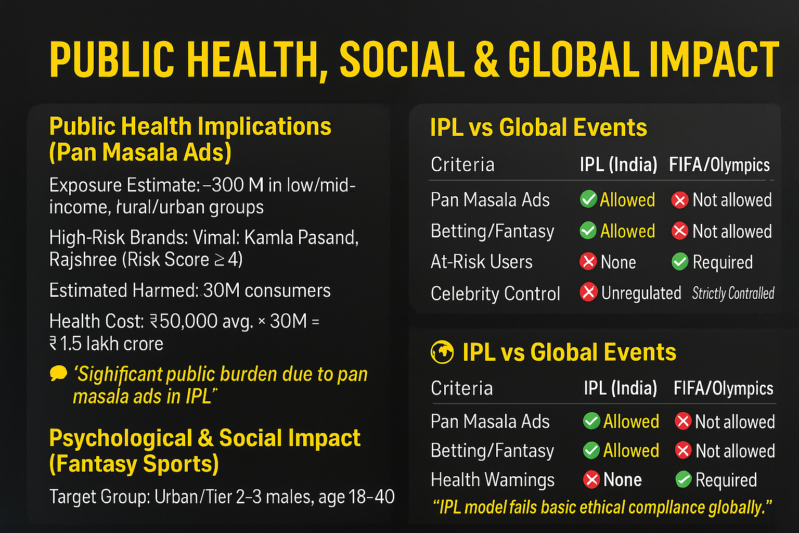

Slide 10
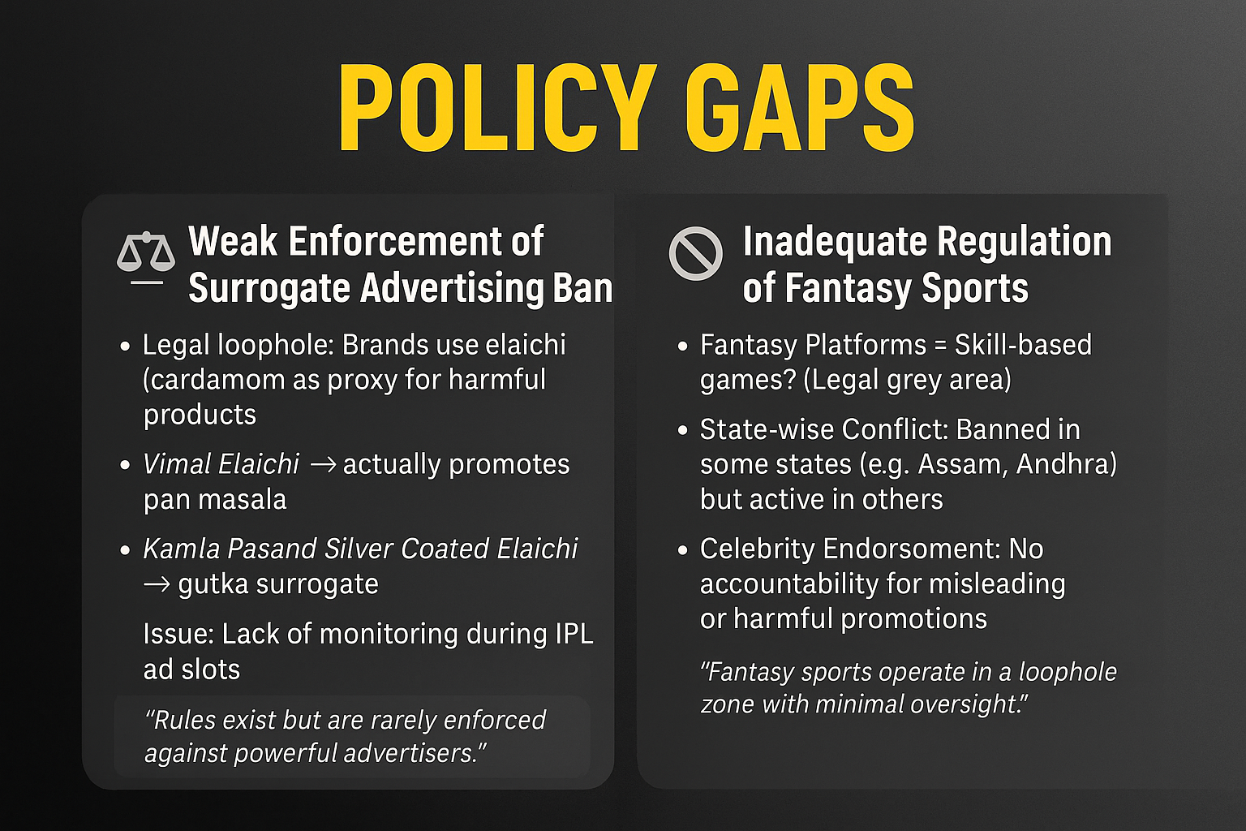

Slide 11
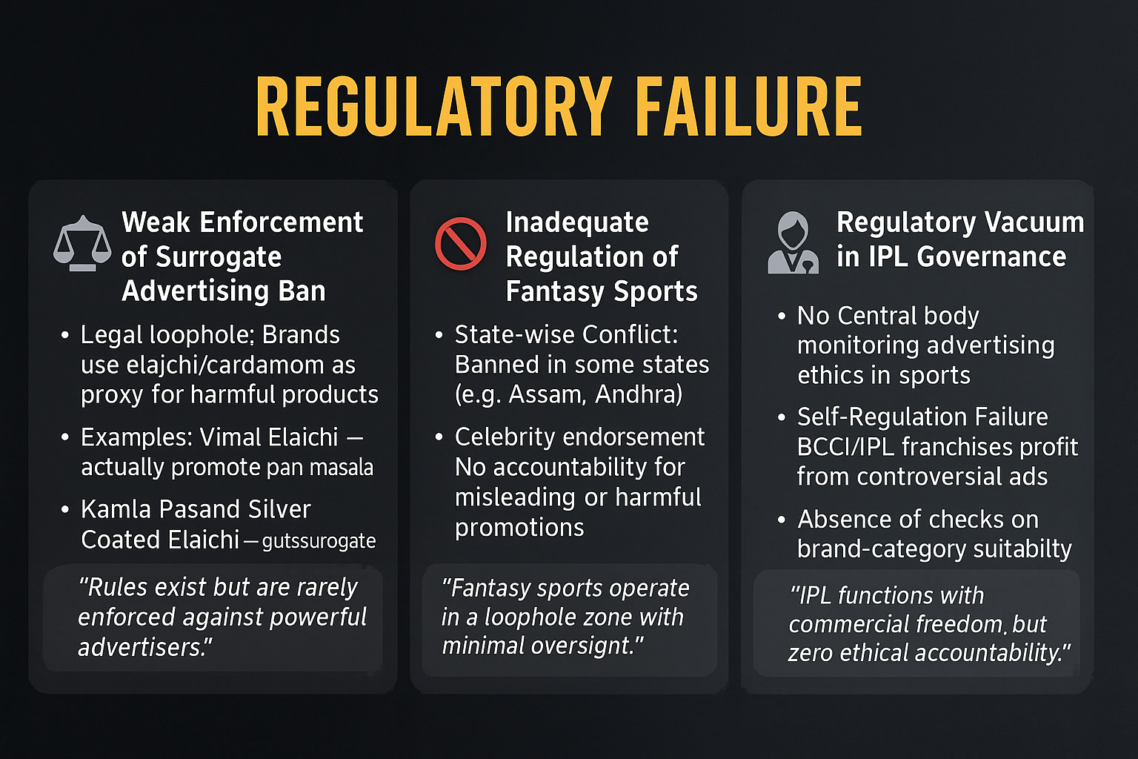

Slide 12
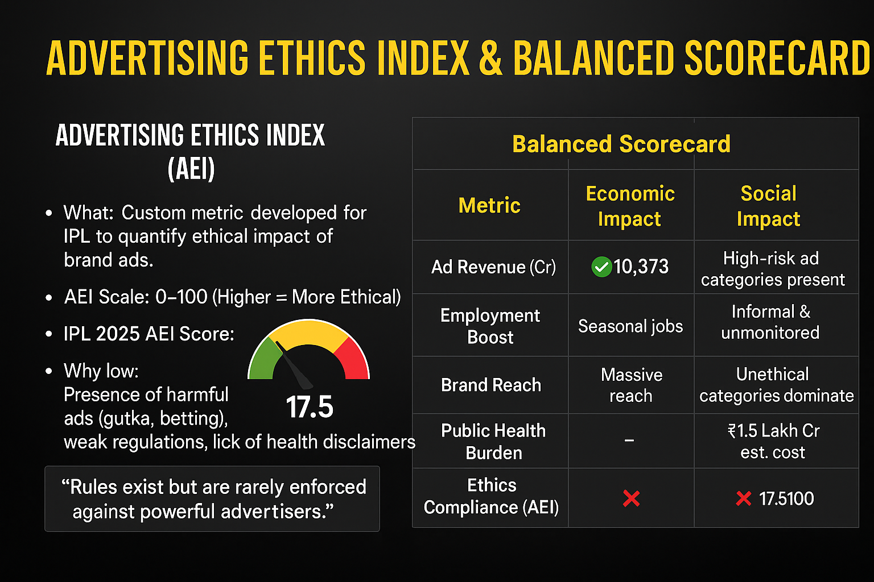

Slide 13
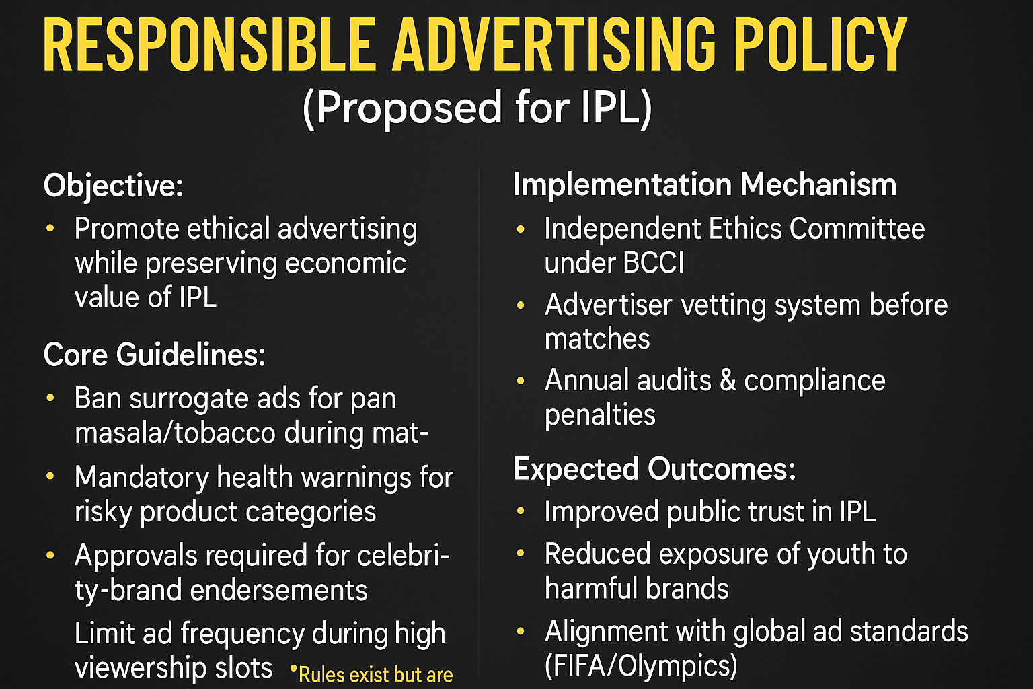

Slide 14
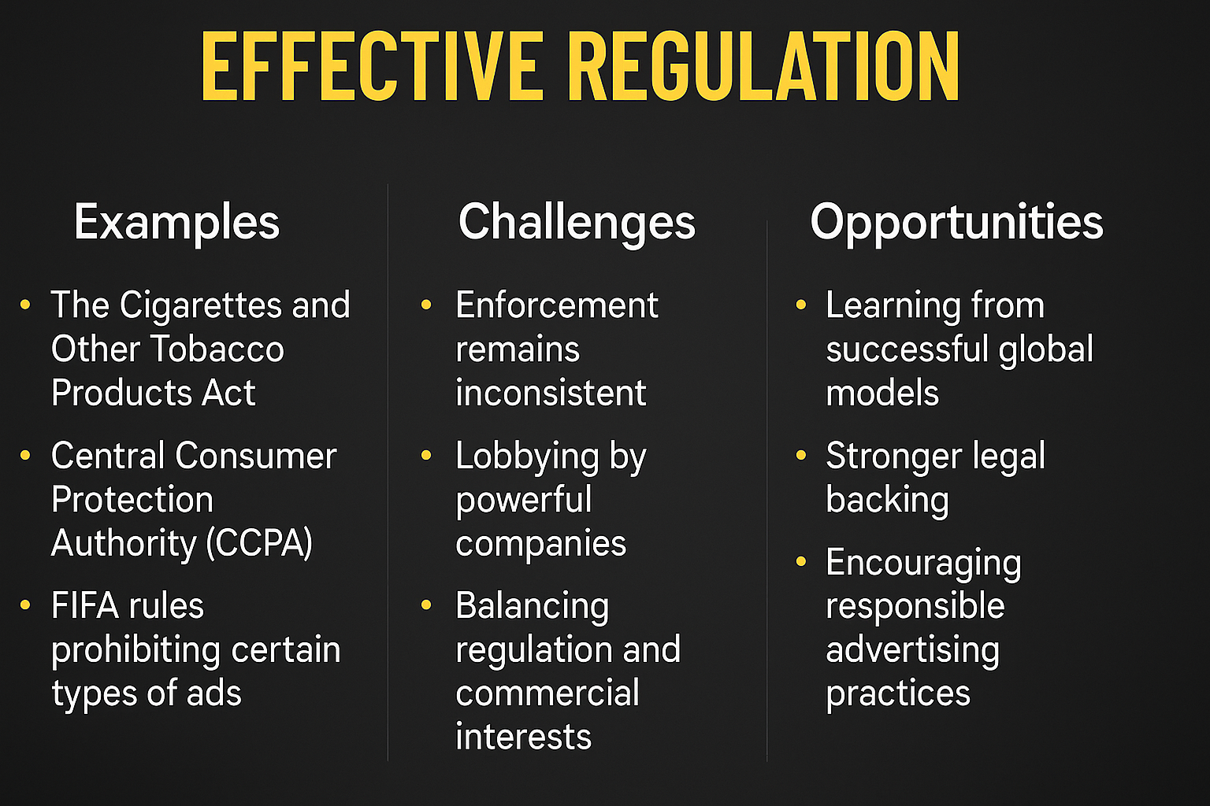

Slide 15
PLAYER ENDORSEMENT ETHICS
⚽ Problem Statement
IPL players are endorsing harmful product categories: pan masala, fantasy apps
Lack of guidelines to assess brand impact before signing deals
No accountability for the public health/social influence of these endorsements
🧑‍💼 Why It Matters
Athletes are aspirational role models, especially for youth
Misleading endorsements normalize risky behaviors (gambling, tobacco)
Damages long-term reputation of both players and IPL
🛡️ Proposed Framework
Ethics review before signing brand partnerships
Public disclosure of endorsement categories
Voluntary “Responsible Athlete Pledge” promoted by BCCI

Slide 16
FUTURE-PROOFING IPL ADVERTISING
🚀 Vision
IPL as a leader in ethical sports advertising globally
Balanced monetization with public trust and responsibility
Align with international standards (FIFA/Olympics)
🧩 Key Strategic Moves
Create an independent Advertising Ethics Council under BCCI
Categorize brands by health/social risk tier before approval
Promote health-positive, youth-focused brands in prime slots
📈 Long-Term Impact
Reduce youth exposure to addictive/harmful ads
Improve India's global image in ethical sports governance
Encourage responsible partnerships between players, brands, fans

Slide 17
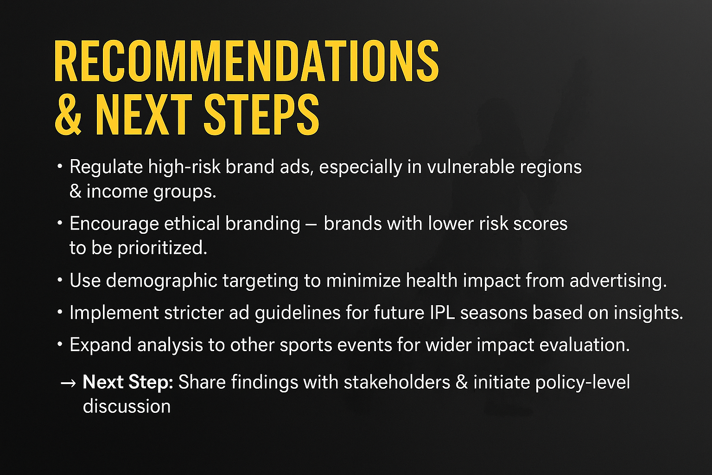

Slide 18
CONCLUSION & LEARNINGS
📌 Project Summary
Analyzed IPL’s 2025 advertising for both revenue and ethical impact
Used SQL (PostgreSQL) + Power BI to derive insights from 4 datasets
Built a KPI-driven dashboard & AEI (Advertising Ethics Index)
🧠 Key Takeaways
High-revenue ads often have serious health/social risks
51M+ potentially impacted; ₹1.5L Cr public burden from pan masala
Fantasy gaming ads exploit legal gray zones
🎓 Personal Learning
Strengthened SQL & data storytelling skills
Learned how to build end-to-end social impact dashboards
Understood how data can drive ethical decisions in business

Slide 19
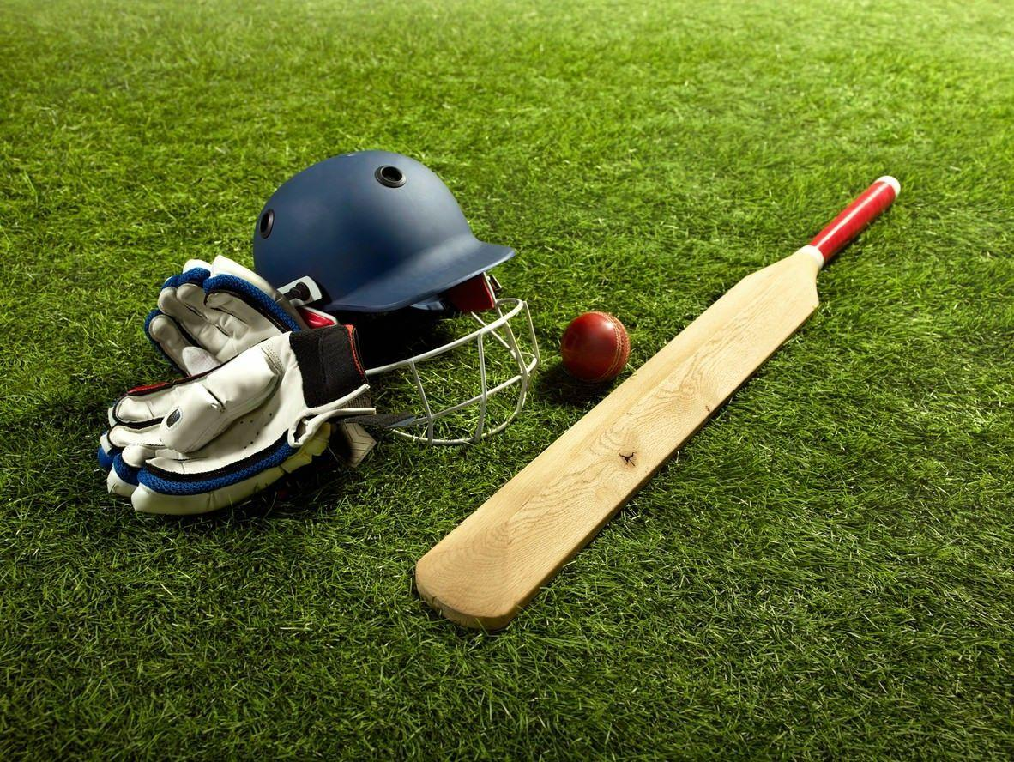
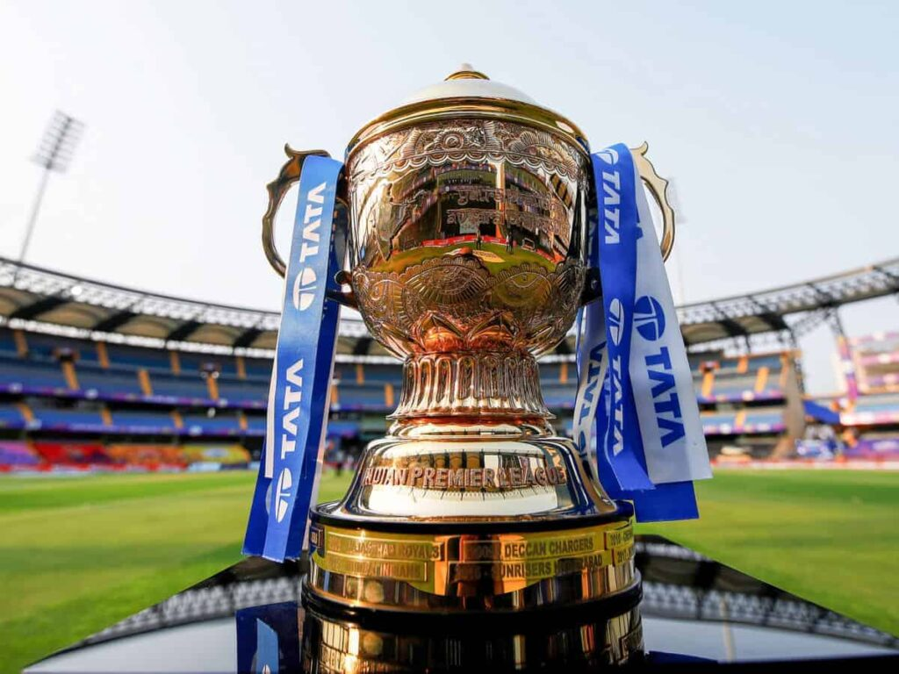
THANKS
A LOT!
ANURAG
MISHRA

